Slide 1






Project Plan
Project:- Movie Recommendation System
Mentor:- Ramya Bhargavi

Slide 2

Agenda
Team
Timeline
Technologies
Overview
Literature Survey
References
Problem Statement
At a Glance

Slide 3

Team :- Data Detectives
Halli Shanu Fakirappa
Saurabh Sunil Hundare
Madamanchi Chandra Vardhan
Prasad Mansing Jadhav
Data Detectives
Sudhir Singh
Ruthvik Bathala
Back to Agenda Page

Slide 4

Overview
The rapid growth of digital media platforms and the availability of vast movie libraries have made it increasingly challenging for users to discover and choose movies that align with their preferences. To address this issue, movie recommendation systems have emerged as a powerful tool to enhance user experience and engagement in the entertainment industry.
OBJECTIVES
GOALS
Enhance user satisfaction through personalized movie recommendations.
Enhance user retention by providing accurate and useful movie recommendations.
Personalize the movie-watching experience based on user preferences.
To Make different types of recommendation techniques like:-
1. Popularity based recommender system
2. Content based Recommender System
3. Collaborative Recommender System
Back to Agenda Page

Slide 5

PROBLEM STATEMENT
Using different techniques of Machine Learning, we need to build a Recommender System that recommends movies based on “ Cast, Genre, Reviews, TMDB/IMDB ratings”
Using different types of recommendation techniques like:
1. Popularity based recommender system
2. Content based Recommender System
3. Collaborative Recommender System
Back to Agenda Page

Slide 6


Timeline
DATA CLEANING
EDA AND DATA VISUALIZATION
MODEL BUILDING
MODEL DEPLOYMENT
Preparing a clean and reliable dataset for a movie recommendation system which is free of every kind of noise and false data.
Implementation of Machine Learning Algorithms KNN and NLP Techniques like TF-IDF for Building a accurate model.
Exploratory data Analysis using Univariate, Bivariate, Multivariate Graphs and multiple Data Visualization Tools.
Deployment of the Model on the User's Site using Streamlit Framework.
Back to Agenda Page

Slide 7
Literature survey
PAPER 1
PAPER 2
Title:-
Title:-
Toward the next generation of recommender systems: A survey of the state-of-the-art and possible extensions.
Hybrid recommender systems: Survey and experiments
This survey paper provides a comprehensive overview of different recommendation techniques, including collaborative filtering, content-based filtering, and hybrid approaches, along with their strengths and limitations.
The author presents a survey of hybrid recommender systems, which combine multiple techniques, such as collaborative filtering, content filtering to improve recommendation accuracy and coverage.
Back to Agenda Page

Slide 8
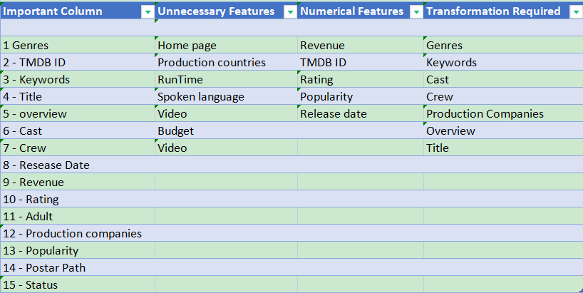
Data Description
Datasets To be used:-
1.movies_metadata.csv
2. credits.csv
3.keyword.csv
4.ratings.csv

Slide 9
At a Glance
Based on the TMDB/IMDB ratings of the Movie.
Content-Based Recommender
Based on the technique that recommends movies based on the preferences and behaviors of similar users.
Movie Recommendation System
Collaborative-Based Recommender
Hybrid-Based Recommender
Combination of all the Models.
Popularity-Based Recommender
Based on the Popularity Of the Movie in Specific Time Period.
Back to Agenda Page

Slide 10




Technologies
LANGUAGES USED:-
Python
ALGORITHMS:-
SVM(Support Vector Machines)
NLP concepts like TF -IDF
FRAMEWORK:-
Streamlit
Natural language Processing
Back to Agenda Page

Slide 11

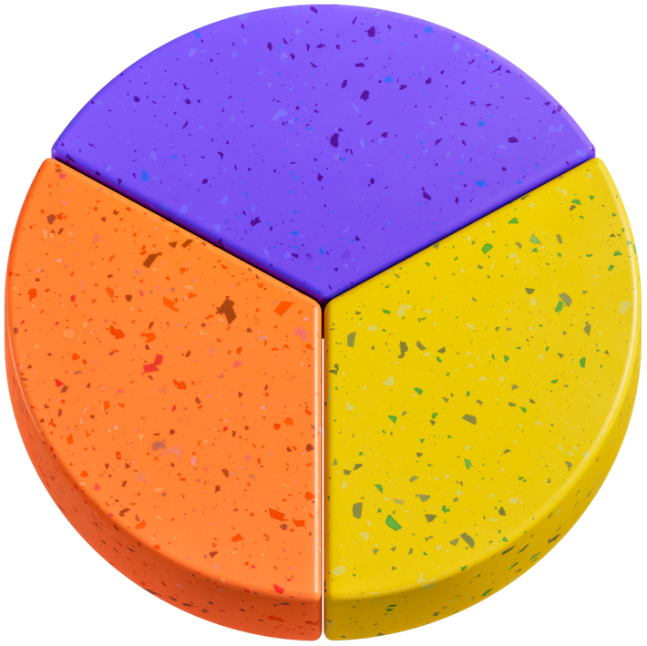
References
https://ieeexplore.ieee.org/abstract/document/1423975
https://link.springer.com/article/10.1023/A:1021240730564
https://www.kaggle.com/code/rounakbanik/movie-recommender-systems/notebook
Back to Agenda Page

Slide 12


